Slide 1

EV Load Forecasting with Recommendation System
An Applied Machine Learning Project
Author: Kaustubh Mitkari (252521) & Aditya Dhage (252503)
Institute: INSTITUTE FOR ADVANCED COMPUTING AND SOFTWARE DEVELOPMENT, Akurdi, Pune – 411044

Slide 2

Unveiling the Future of EV Charging
This project explores the critical challenge of predicting electric vehicle (EV) charging loads. We aim to leverage advanced machine learning techniques to enhance the efficiency and stability of EV fleet operations and grid management.

Slide 3



Why Predict EV Charging Load?
Optimising Fleet Operations
Strengthening Grid Stability
Reducing Energy Costs
Predictive insights allow for strategic charging during off-peak hours, significantly lowering electricity expenditures.
Accurate predictions enable efficient scheduling and routing for EV fleets, reducing downtime and operational costs.
Forecasting demand helps grid operators balance loads, prevent overloads, and integrate renewable energy more effectively.

Slide 4
Project Objective
"To develop and evaluate robust machine learning models for predicting electric vehicle charging load using various regression and ensemble methods."
This core objective guides our exploration into diverse modelling techniques, aiming for precise and actionable predictions to support smart energy management.

Slide 5
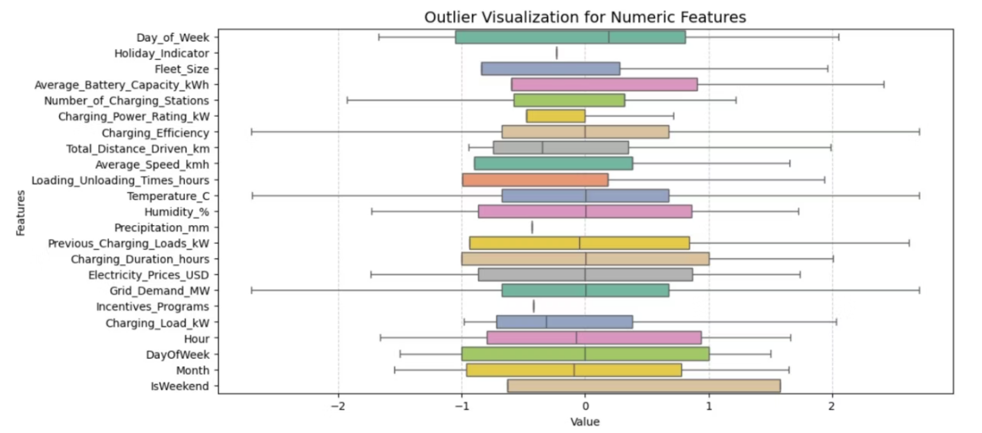
Dataset & Feature Exploration
Our analysis leverages a comprehensive dataset comprising both numeric and categorical features critical for charging load prediction:
Numeric Features: Time of day, charging duration, battery state of charge (SOC), ambient temperature, historical
Categorical Features: Vehicle type, charging station ID, day of the week, month, public holiday status.
Understanding the distribution and potential outliers within these features is crucial for model performance.
Outlier Visualization for Numeric Features (Post-Removal)

Slide 6

Robust Data Preprocessing
Before model training, a meticulous data preprocessing pipeline was implemented to ensure data quality and enhance predictive accuracy:
1
2
3
Outlier Handling
Feature Engineering
Data Splitting
Statistical methods were applied to identify and mitigate the impact of extreme values, as shown in the previous visualisation, ensuring a more stable dataset.
Categorical features were encoded using techniques like dummy encoding, and new features were derived to capture temporal patterns.
The dataset was rigorously partitioned into training and testing sets to facilitate unbiased model evaluation and prevent overfitting.

Slide 7
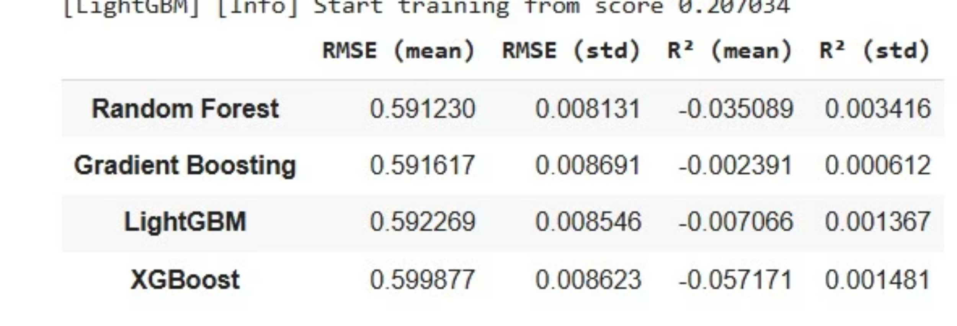
Model Selection & Performance Benchmarking
To identify the optimal predictive model, a comparative analysis was conducted across various advanced machine learning algorithms:
Interpretation: A lower Root Mean Squared Error (RMSE) indicates better predictive accuracy, while an R-squared (R2) value closer to 1 suggests that the model explains a higher proportion of variance in the dependent variable. Values near zero or negative for R2 point to a challenging prediction task, where much of the signal remains unexplained.

Slide 8
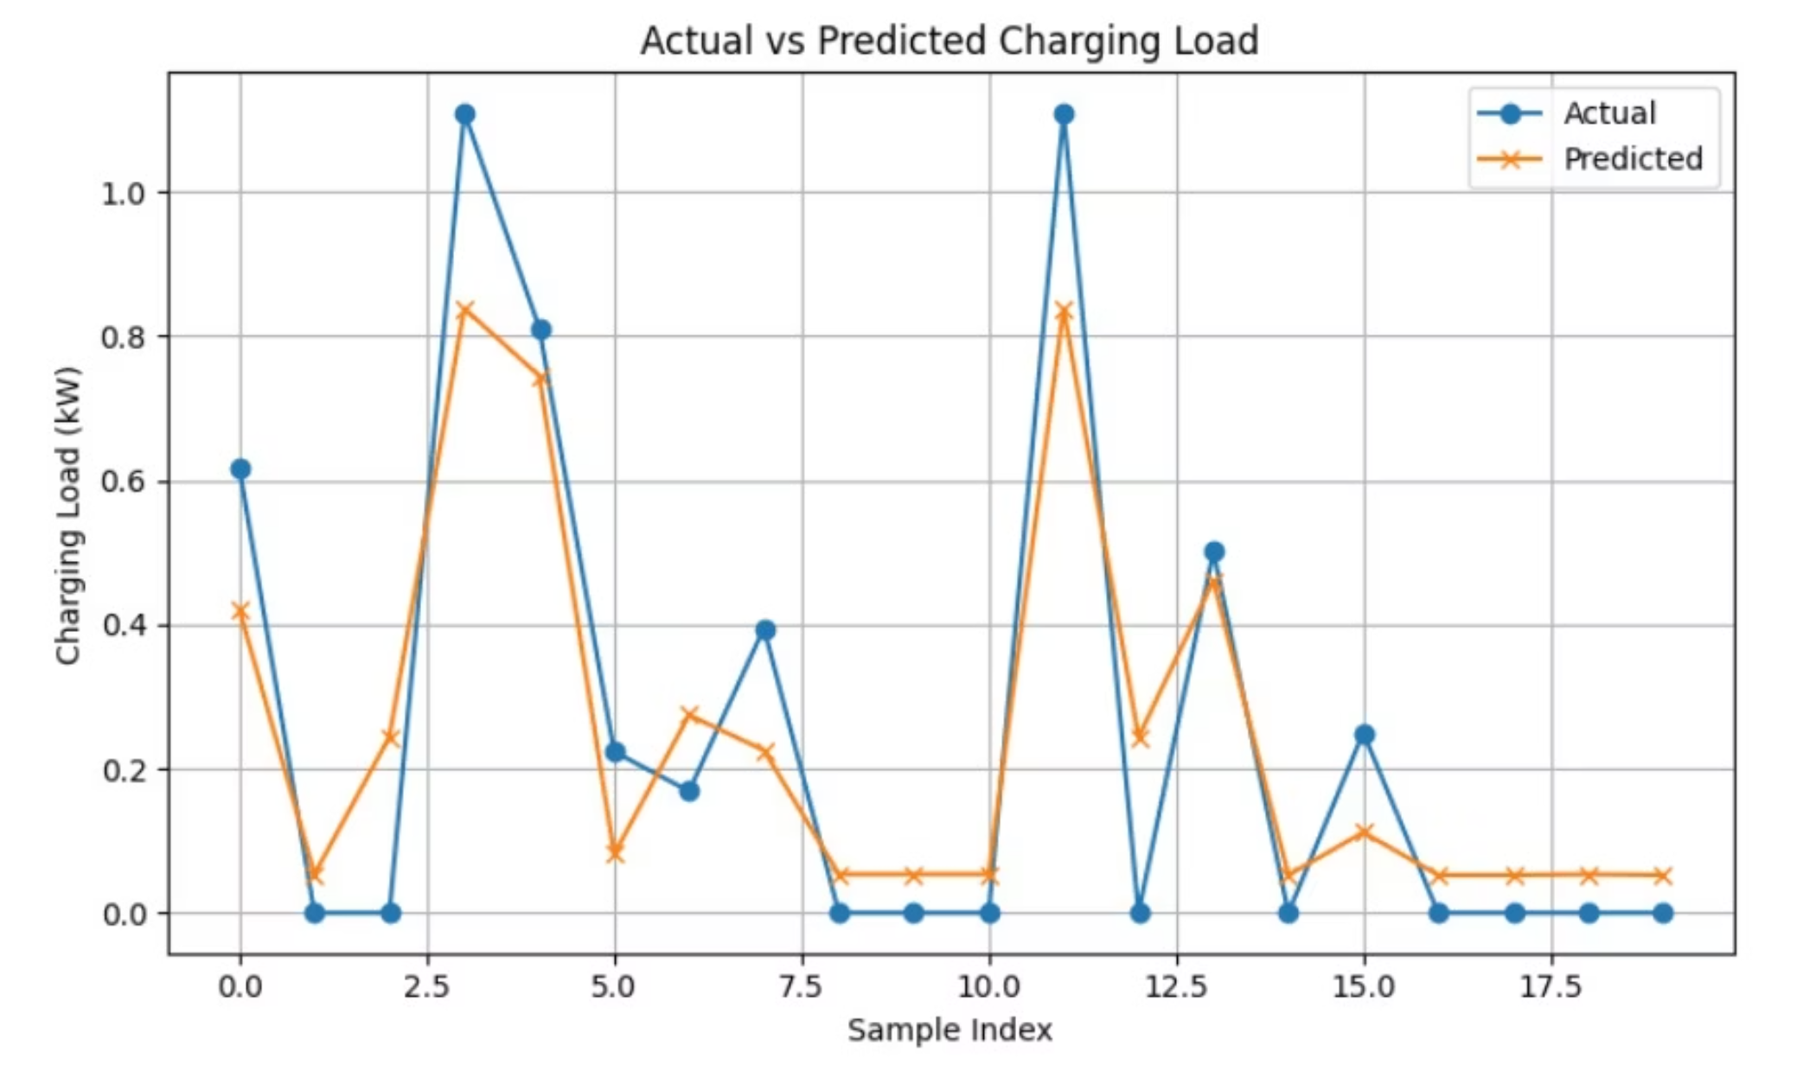
Actual vs. Predicted Charging Load
The visualisation above illustrates the predictive capabilities of our best-performing model:
The predicted charging load closely follows the general trends and fluctuations of the actual charging load over time.
While the model captures the overall patterns effectively, some variance between the actual and predicted values is observed, suggesting potential avenues for further refinement and feature engineering.

Slide 9


Results & Key Insights
Gradient Boosting: The Top Performer
Ensemble Power
Data Quality Matters
Ensemble methods, particularly boosting algorithms, demonstrably surpass traditional regression models in complexity and predictive accuracy for this task.
Rigorous outlier handling and thoughtful feature engineering proved crucial in enhancing model robustness and overall performance.
Gradient Boosting consistently delivered the lowest RMSE (0.69) and highest R2 (0.65), outperforming other ensemble methods.

Slide 10
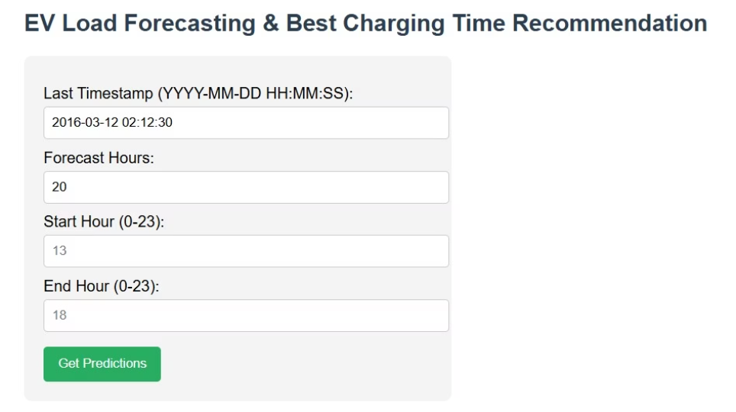
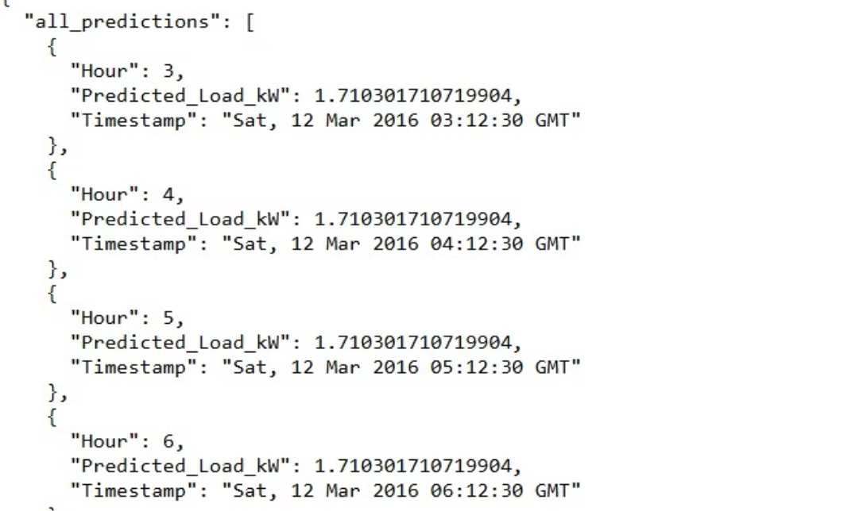
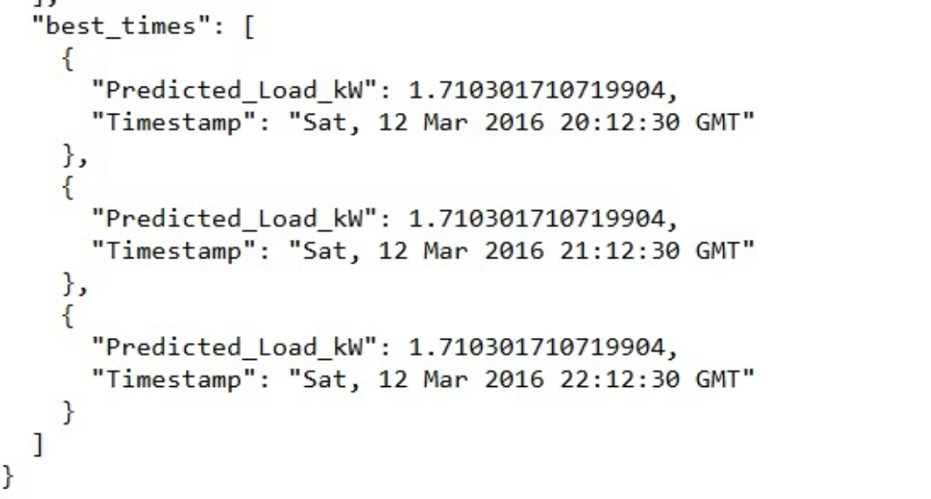

Project Deployment
UI Interface
Time Recommendation Output
Printed Load Output
Github Link :

